Slide 1

Choosing the best city for a living
Diana Tolstyga

Slide 2
Choosing the best European city
There are three cities to choose from: Paris, London, Amsterdam;
All three cities are comparable in terms of way and level of living except downtown infrastructure that needs to be evaluated using Data Science technics;
To evaluate downtown infrastructure, the Foursquare data are used.

Slide 3
Data acquisition and cleaning
Neighbourhoods are selected from postal-codes site https://postcode.site;
Longitude/latitude of neighborhoods are manually collected from google maps;
Venues are taken from Foursquare portal;
Venue categories are manually ranked based on personal preferences

Slide 4
Evaluation model with two-way approach
Select the most diverse neighborhood via k-clustering analysis of venues by its category. The more clusters are represented in a neighborhood the higher its rating;
Calculate ranking of a neighborhood based on rating scale of venue categories. Each category has a rating from 1 to 10 based on our own preferences.
The final ranking of a neighborhood is the sum of the two ratings.

Slide 5
First ranking approach
For each city we hove got k clusters and choose the neighborhood which has the most number of different clusters.
If a neighborhood is having all clusters represented, it gets the highest score meaning that the neighborhood is very diverse having venues of various types

Slide 6
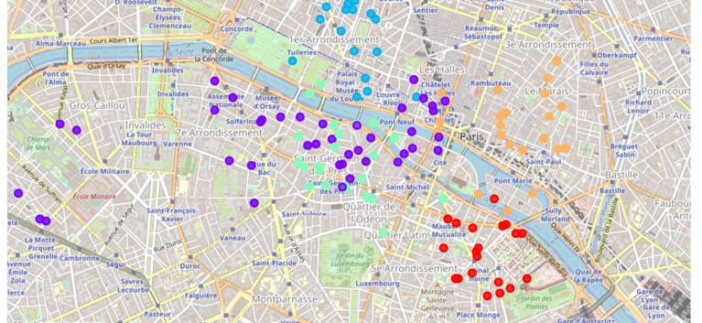

Clusters for Paris Neighborhoods
Venue categories are divided into five clusters;
Quartier latin has the highest rating and ends up being the most diverse
while Eiffel Tower has the lowest one.

Slide 7

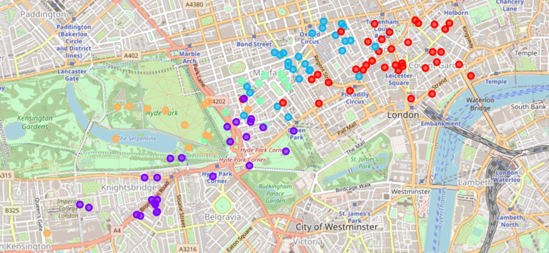
Clusters for London Neighborhoods
Venue categories are divided into five clusters;
Covent Garden has the highest rating and ends up being the most diverse
while Kensington has the lowest score.
This Photo by Unknown Author is licensed under CC BY-NC

Slide 8
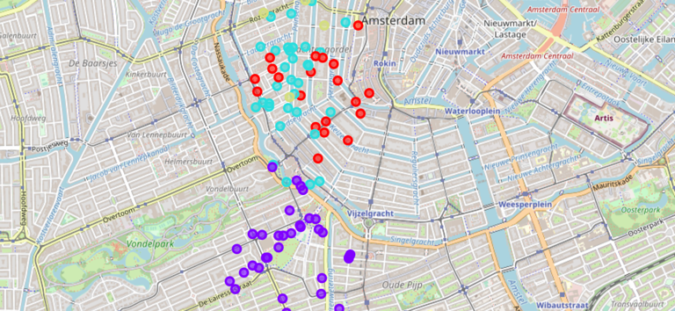

Clusters for Amsterdam neighborhoods
Venues are segmented into three clusters
It turns out that all neighborhoods are equally rated
This Photo by Unknown Author is licensed under CC BY-SA

Slide 9
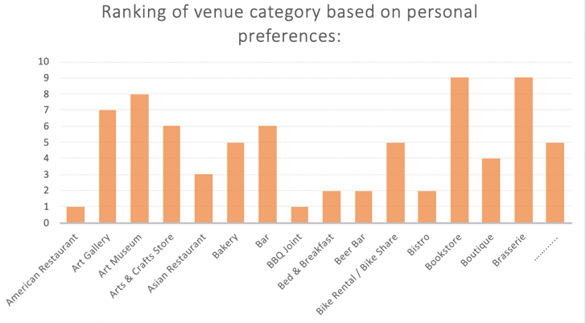
Second ranking approach
We use our personal preferences to rank each out of 208 venue categories from 1 to 10
By Summing up its weighted values we will get a ranking for each neighborhood

Slide 10
Total ranking of cities neighborhoods
Total ranking is a sum of the two rankings calculated by using two approaches;
Paris is ahead by a large margin having three out of five neighborhoods better than any neighborhoods in other cities;
Taking “1nd Arrondissment of Paris” as a basis, best neighborhoods in London and Amsterdam are 14-18 percentage points below of the best neighborhood in Paris
Paris: | Neighborhood: | 1nd arrondissement of Paris | Eiffel Tower | Le Marais | Quartier Latin | Saint-Germain-des-Prés
 | Total ranking: | 170.9 | 67.08 | 151.23 | 159.37 | 137.4
London: | Neighborhood: | Carnaby | Covent Garden | Kensington | Knightsbridge | Mayfair
 | Total ranking: | 107.05 | 140.38 | 46.63 | 78.95 | 93.99
Amsterdam: | Neighborhood: | Concertgebouwbuurt | Elandsgrachtbuurt | Felix Meritisbuurt
 | Total ranking: | 146.41 | 109.32 | 130.37

Slide 11

Conclusions and further applications
Paris is the best city for a living based on our two-way approach;
For further analysis the number of neighborhoods can be extended;
The evaluation metrics can also be complicated taking into consideration other factors: housing costs, commute,school rating, climate etc.

